Slide 1


SCUBA Adventure Program

Slide 2

Brief History of Sea Base
The Sea Base began in the early 1970's as a local program in the Florida Keys called the Florida Gateway to High Adventure under the guidance of Sam Wampler, a professional Scouter from the South Florida Council. It offered primarily sailing programs using local marinas and chartered boats sailing to the Bahamas and back. As the idea caught on and grew, it joined the high adventure offerings of the National Council of Scouting America along with Philmont Scout Ranch and the Northern Tier High Adventure Base. In 1979 the Sea Base acquired a permanent facility on Lower Matecumbe Key and when this opened for Scouts in 1980 it was renamed the Florida National High Adventure Sea Base. As the popularity of this program grew, scuba diving was added and in 1984 Scouting America received the gift of Big Munson Island from Homer Formsby. This undeveloped island offered tremendous program potential as an outpost for primitive camping, Robinson Crusoe style. During this time period the sailing program concentrated on sailing around the fabulous Florida Keys. New sailing programs were started that originated and ended in Marsh Harbour in the beautiful Abaco Islands of the Bahamas.

Slide 3
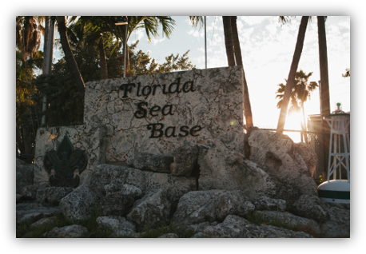
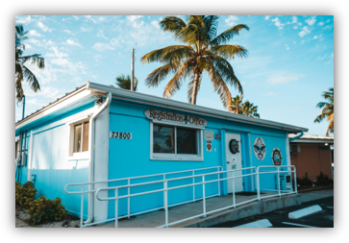
Arrival and Registration
Arrival Time is 1 PM
Check in
Meet your Professional Sea Base Divemaster
Check into Scuba Dorms
Crew Photos taken
Issue Equipment
Scuba Review
Swim Review

Slide 4
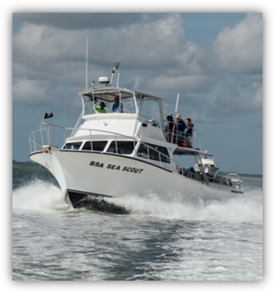
Weekly Schedule
Arrival Day Registration, swim test and scuba skills review
Orientation and Dive Against Debris
Day Two Scuba Review make up/Land Navigation
Open Water Dive 1 & 2
Evening Program – Fish Identification
Day Three Open Water Dives 3 & 4
Snorkel Award
Evening Programs – Coral Restoration Foundation
Day Four Open Water Dives 5 & 6
Night Dive Program
Night Dive (Dive 7)

Slide 5
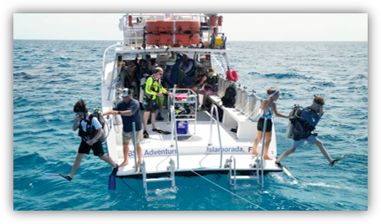
Weekly Schedule (continued)
Day Five Open Water Dives 8 & 9
Evening Program – Shark Awareness
Day Six Open Water Dives 10 & 11
Clean and return scuba equipment
Luau
Day Seven Departure
Schedule is weather dependent

Slide 6




Skills and Explorations Your Crew Will Accomplish
Compass Navigation Skills Dive Against Debris
Natural Navigation Skills Coral Bleaching Identification
Advanced Buoyancy Skills Night Diving Skills
Reef Fish and Invertebrate Identification

Slide 7
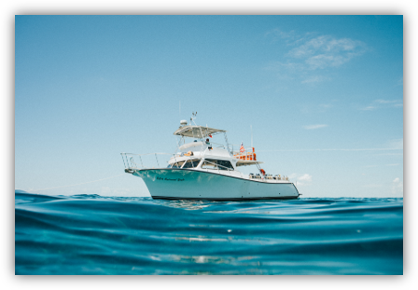
Certifications and Awards
S.C.E.N.E.S. Ambassador Award
Snorkel Award
Duty to God

Slide 8
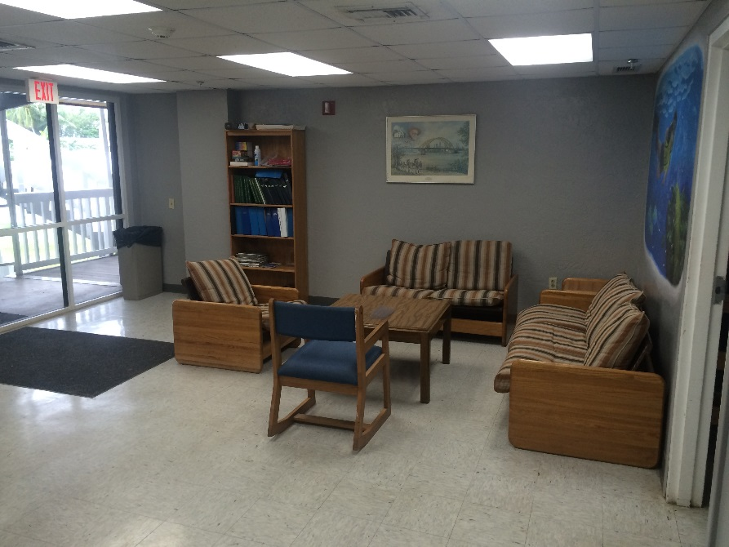
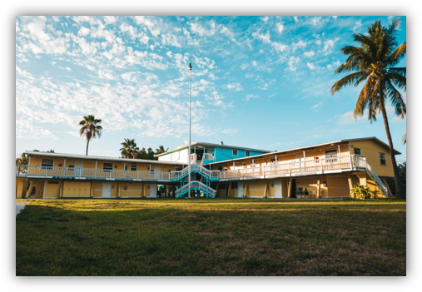
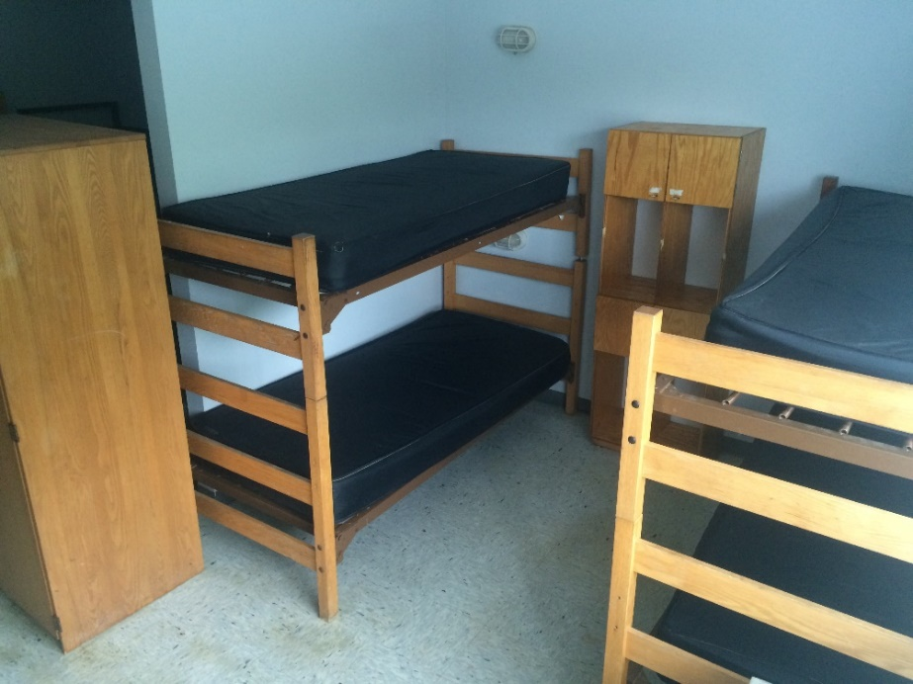
Dorm
Dorms are provided for single and double crews
Please bring your own bedding, mattresses are provided
Separate dorm rooms for women
All rooms are air conditioned

Slide 9


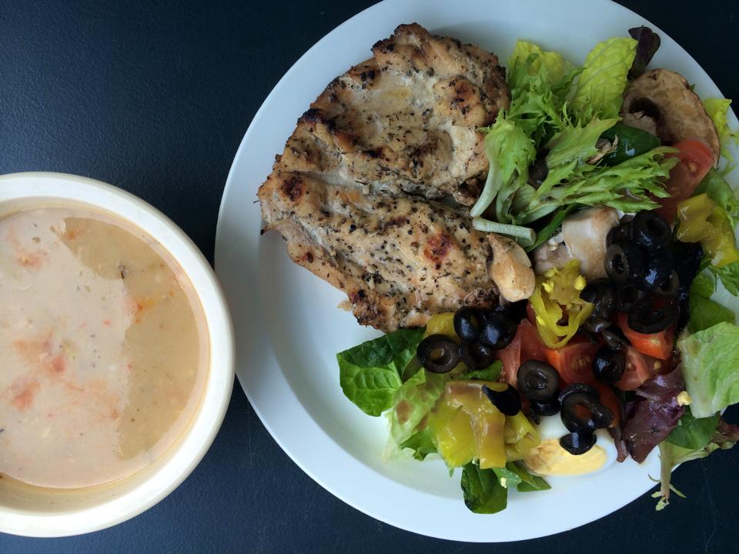
Galley
All meals served at the galley
Packed lunches while on the boats
Those with special food needs please
contact us prior to your arrival
FSB.Galley@scouting.org
Sea Base Blessing
Bless the creatures of the Sea
Bless this person I call me
Bless the Keys you made so grand
Bless the sun that warms the land
Bless the fellowship we feel
as we gather for this meal
Amen

Slide 10
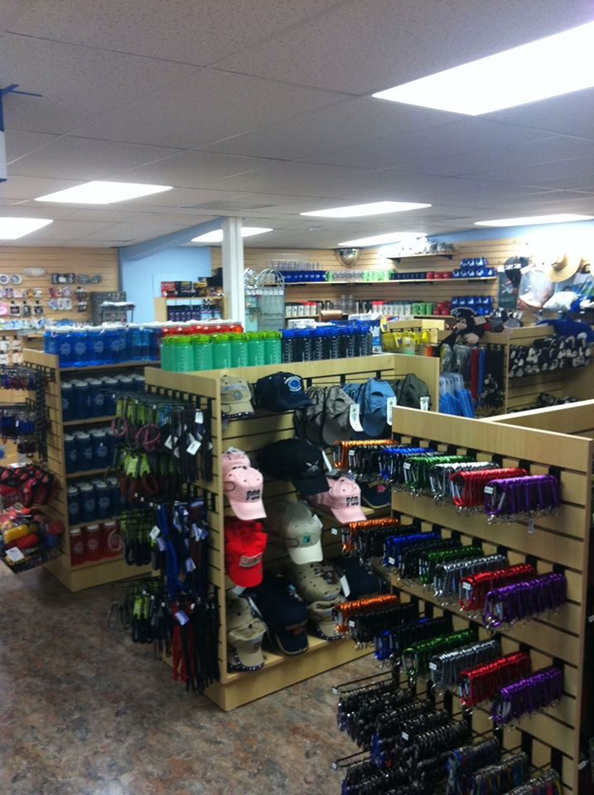
Ships Store
Open Everyday during season
Order Custom Crew Apparel
Shirts
Hats
Duffel Bags
*Custom orders must be placed six weeks prior to arrival
Reserve wetsuits
Purchase Mask and Snorkels
Water bottles, sunscreen and a large
assortment of souvenirs.
store.bsaseabase.org

Slide 11


Scuba Equipment
Sea Base is proud to offer Aqualung and Scubapro as our scuba equipment providers. The following equipment is provided for your adventure.
BC’s with weight integration
Regulators with alternate air sources
3 gauge consoles include pressure gauge, depth gauge and compass
(dive computers not provided or available for rent)
Dive light provided for night dives
Sea Base will also provide fins, a snorkel vest and mesh bag.
It is recommended that participants purchase fins and practice using them during any pool sessions scheduled as a part of their Sea Base training plan.

Slide 12
Scuba Equipment
Sea Base does not provide nor rent the following equipment
Mask & snorkel
Dive Watch
Dive computers (not required)
Full wetsuits available for rent (only needed for spring programs)
Masks, snorkels and dive watches are available for purchase through the Ships Store

Slide 13
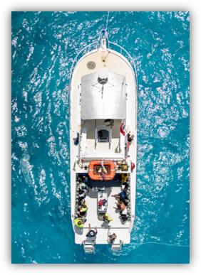
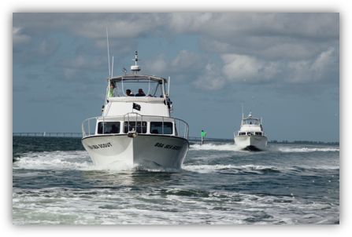
Dive Boat Fleet
Five 46 ft. Newton dive boats built for our divers
One 36 ft. Newton dedicated to certification classes
All boats are US Coast Guard Inspected and have Oxygen,
AED’s, underwater recall systems, First Aid Kits, Marine Head,
EPIRB and VHF Radios.

Slide 14
Scuba Medical Document Procedure
Documents that are needed for the Scuba Adventure Programs will be sent to your Crew Leader for you to review. All documents are loaded onto your personal CampDoc account. The Crew Leader will be responsible for supplying CampDoc with the names, date of birth and an adults email address to set up your personal CampDoc profile. You will then be able to complete and upload the forms on the CampDoc system.
  For Spring crews this is due no later than January 1st
  For Summer crews this is due no later than March 1st
Documents returned after the deadline may affect your crew’s ability to participate in their full adventure.
*As a special note: It is suggested that you keep a copy of the Scouting America Medical and RSTC Diver Medical Questionnaire for your personal records.

Slide 15
Scuba Medical Document System
Required documents for Scuba Adventure:
Scouting America Parts A, B and C signed by a physician (MD, DO, PA or NP)
RSTC Diver Medical Questionnaire signed by a physician (MD, DO, PA or NP)*
PADI Diver Activities Release*
Scuba Certification Card (both sides)
PADI Florida Addendum Notice to the Minor Child’s Parent
*These are two or three page documents and all pages are required
If there is a participant that is in a Severe-Risk or Relative-Risk category or is taking a prescribed medication for ADD, ADHD or depression, this document must be signed by an MD or DO only.

Slide 16

Medical Fitness for Scuba Diving
The following pages are meant to be a guide for the more common conditions and not an absolute list. If you have a medical condition that may be of concern, please contact the Scuba Department at Sea Base for guidance.
The final decision for participation in all Sea Base programs is at the discretion of the
Sea Base Medical Director. The decision is final, and we are unable to reverse or alter that decision.
No waivers will be issued.

Slide 17
Absolute medical contradictions for scuba diving with
Scouting America
Asthma
Epilepsy/Seizures
Insulin dependent diabetes
Multiple (more than one) medication for ADD, ADHD or depression
Anxiety requiring medication
Narcolepsy
Spontaneous pneumothorax
Exceeding the weight limit of 295 pounds
Migraines with auras
Loss of hearing in one ear
Blood thinners
NOTE: For additional information read the detailed description on the following slides or in the Participant Guide.
Not every disqualifying medical condition for scuba diving is listed
The final decision for participation in all Sea Base programs is at the discretion of the
Sea Base Medical Director. The decision is final, and we are unable to reverse or alter that decision.
No waivers will be issued.

Slide 18
Risk factors for Scuba Diving with Scouting America
Ear and Sinus Problems ● Panic Disorder
Recent surgery ● Active psychosis
Leukemia ● Certain Medications
Chemotherapy ● Migraines requiring medication
Sickle-cell disease ● Pregnancy
● Pacemakers
NOTE: For additional information read the detailed description on the following slides or in the Participant Guide.
Not every disqualifying medical condition for scuba diving is listed
The final decision for participation in all Sea Base programs is at the discretion of the
Sea Base Medical Director. The decision is final, and we are unable to reverse or alter that decision.
No waivers will be issued.

Slide 19
Medical Fitness for Scuba Diving
Scouting America Annual Health and Medical Record Part C and RSTC Diver Medical Questionnaire must be signed by a physician (MD, DO, PA or NP only) within the last year. If there is a participant that is in a Severe-Risk or Relative-Risk category or is taking a prescribed medication for ADD, ADHD or depression, this document must be signed by an MD or DO only.
Medical issues:
Hypertensive: Blood pressure must be lower than 140/90 prior to arrival at Sea Base.
The final decision for participation in all Sea Base programs is at the discretion of the
Sea Base Medical Director. The decision is final, and we are unable to reverse or alter that decision.
No waivers will be issued.

Slide 20
Medical Fitness for Scuba Diving
Seizures (Epilepsy):
Seizures while snorkeling or scuba diving are extremely dangerous and often fatal.
Diving or snorkeling as part of an official scouting activity is prohibited for participants with a history of seizures
No participant with a history of seizures or taking anti-epileptic medication may snorkel or scuba dive. Prospective
participants with a history of febrile seizures may be considered for snorkeling or scuba diving after a formal
consult with their neurologist.
The final decision for participation in all Sea Base programs is at the discretion of the
Sea Base Medical Director. The decision is final, and we are unable to reverse or alter that decision.
No waivers will be issued.

Slide 21
Medical Fitness for Scuba Diving
Weight Limits:
Due to rescue equipment restrictions and evacuation efforts from remote sites, under no circumstances will any individual exceeding 295 pounds be permitted to participate. Anyone arriving at Sea Base exceeding 295 pounds will be sent home at their own expense. No refund will be given.
Concussions:
Those participants who have suffered a concussion and any side effects from the concussion should contact Sea Base to discuss this issue. Please provide the following information on the Scouting America Medical:
  When did the injury occur?
  Was there any loss of consciousness, inability to recollect events?
  Were there reports of disorientation after the incident?
  Have there been any lingering affects?
The final decision for participation in all Sea Base programs is at the discretion of the
Sea Base Medical Director. The decision is final, and we are unable to reverse or alter that decision.
No waivers will be issued.

Slide 22
Medical Fitness for Scuba Diving
Psychological and Emotional Difficulties (ADD, ADHD, anxiety and depression)
Any condition should be well controlled
Diving as part of an official scouting activity is prohibited for
  Participants taking more than one medication for any of these conditions
  Participants with anxiety disorder requiring medication
Anxiety Medication: Participants with anxiety requiring medication will not be cleared to scuba dive.
***Medications***
Participants, youth or adult, taking multiple medications for ADD, ADHD, depression or any psychological condition will not be cleared for scuba diving. Those Participants requiring medication to control anxiety will not be cleared for scuba diving. Those that are currently certified or have a physician’s approval for scuba diving will not be cleared to scuba dive at Sea Base. There are no exceptions, exclusions or waivers to this policy.
The final decision for participation in all Sea Base programs is at the discretion of the
Sea Base Medical Director. The decision is final, and we are unable to reverse or alter that decision.
No waivers will be issued.

Slide 23
Medical Fitness for Scuba Diving
Asthma or Reactive Airway Disease:
Diving as part of an official scouting activity is prohibited for persons being treated for asthma or reactive airway disease
Persons with a history of asthma who have been asymptomatic and have not used medications to control asthma for five years or more may be allowed to scuba dive if resolution of asthma is specifically confirmed by their physician and includes provocative pulmonary function testing conducted by a pulmonologist.
—Provocative testing can include exercise, hypertonic saline, a hyperpnea test, etc.
∗∗∗Asthma Information∗∗∗
Participants, youth or adult, with asthma will not be cleared to scuba dive. The predisposing factors, severity of attacks or intermitted asthma does not change this Scouting America policy. Those that are currently scuba certified or have a physician’s approval for scuba diving will not be cleared to scuba dive at Sea Base. There are no exceptions, exclusions or waivers to this policy.
The final decision for participation in all Sea Base programs is at the discretion of the
Sea Base Medical Director. The decision is final, and we are unable to reverse or alter that decision.
No waivers will be issued.

Slide 24
Medical Fitness for Scuba Diving
Diabetes:
Diving as part of an official scouting activity is prohibited for the following
  For persons under the age of 18 with a diagnosis of diabetes
  Persons using insulin to control diabetes
  Persons with diabetes, who are non-insulin dependent and who have had recurrent problems and/or hospitalizations for diabetic problems
  Persons with any HbA1c test greater than 7.0 in the previous 12 months
  Persons having a documented or suspected hypoglycemic event requiring treatment or assessment in the previous 12 months
Diabetes is considered well-controlled when the following are met:
  The acceptable oral medications for diabetic control are as single agents only: metaformin and metformin analogs; DPP-4 inhibitors ( sitagliptin, vildagliptin, alogliptin, saxagliptin and linagliptin); or SGLT2 inhibitors and analogies
  Persons over the age of 18 who control their diabetes with exercise and diet (without the aid of medication, except metformin) and documents HbA1c test value less than 7.0 in the last 6 months) may be cleared to scuba dive.
∗∗∗Diabetes Information∗∗∗
Participants that are insulin dependent, youth or adult, will not be cleared to scuba dive. Those that are currently scuba certified or have a physician’s approval for scuba diving will not be cleared to scuba dive at Sea Base. Participants younger than 18 years of age with diabetes will not be cleared to scuba dive. There are no exceptions, exclusions or waivers to this policy.
The final decision for participation in all Sea Base programs is at the discretion of the
Sea Base Medical Director. The decision is final, and we are unable to reverse or alter that decision.
No waivers will be issued.

Slide 25
Crew Leader Information
Medicals in on time to avoid disappointments
At least one adult leader must have a Wilderness First Aid and CPR certification
All adults, 18 years of age or older must have up to date:
Youth Protection Training
Scouting America Safe Swim Defense
Scouting America Safety Afloat
Scouting America Hazardous Weather Training
Scouting America Membership Card -Every participant, both youth and adult must present their Scouting America Membership Card upon arrival at Sea Base. Any person without a membership card will not be permitted to participate in the adventure nor can they remain on base. Those attempting to register with Scouting America upon arrival will not be cleared to participate. Sea Base will not accept rosters in place of individual cards. Sea Base will accept either a hard copy, a photocopy, or an electronic copy of membership cards.

Slide 26
FAQ’s
What Scuba Certification cards does Scouting America-SB Recognized?
Scouting America and Sea Base only accept certification from RSTC
recognized training agencies which include IDEA, NASDS, PADI, SDI/TDI,PDIC, SSI, YMCA
NAUI, RAID, IANTD, NASE and SNSI and others that are members of the Recreational Scuba Training Council. No other certification cards are accepted. We cannot accept restricted cards.
May I bring my own scuba equipment?
Yes, but it will be inspected by our professional staff. If it does not meet our
requirements you will have to use our equipment. Do not bring dive knives or spear guns.
Are Wet suits provided?
Weekly rentals are available through the Ships Store. They are not needed during the summer.

Slide 27


FAQ’s
FAQ’s
What if I arrive at Sea Base and I exceed the height/weight limit?
You will not be permitted to participate in a program or stay at Sea Base.
What if I arrive without a signed medical?
All medical documentation must be submitted in advance and signed by a physician.
You will not be permitted to participate in a program or stay at Sea Base.
If I am unable to scuba dive, may I participate as a snorkeler?
Possibly, certain medical conditions may not allow you to participate as a snorkeler.

Slide 28
FAQ’s
Recommendations on What to Bring
1 Long sleeve shirt • Water bottle
1 Short sleeve shirt • 1 Sleeping cover
Wide brimmed hat • Polarized sunglasses
Dive logbook • 2 towels
Reef Safe sunscreen • Water Resistant watch
2 pair of shorts (1 swim trunks, 1 regular) • Toiletry kit
Light pants • Flashlight
3 Pairs of socks (1 being neoprene swim socks) • Camera
2 Pairs of shoes (1 athletic, 1 sandals) • Insect repellent
Light rain jacket • Spending money ($100-$150)
2 Locks (key or combination per crew) ● Mask and Snorkel

Slide 29
FAQ’s
What NOT to Bring
Spear guns
Dive knives
Firearms
Fireworks
Aerosol sunscreen or bug spray
Deck shoes

Slide 30
Contact Details
Name | Position | Email | Phone
Joe Angelo | Scuba Director | Joe.Angelo@scouting.org | 305-664-5625
Ian Kessler | Sr. Office Assistant (Registration & Medical Upload Support) | Ian.Kessler@scouting.org | 305-664-5627
Dylan Cordle | Islamorada Director of Program | Dylan.Cordle@scouting.org | 305-664-5626
Sea Base Info | General Contact | SeaBase.Events@scouting.org | 305-664-4173
FAX: |  | 305-664-2039

